Slide 1

Mutual Fund Analytics Capstone Project
Subtitle:
Data Engineering, Performance Analytics & Business Intelligence Dashboard
Tools Used: Python | Pandas | SQL | SQLite | Power BI | Plotly | Seaborn | GitHub
Prepared By: Sakshi Kumari
Duration: 6-Day Analytics Project

Slide 2
Problem Statement & Objectives
Problem Statement
India's mutual fund industry has witnessed rapid growth in AUM, SIP inflows, and investor participation. However, investors and financial advisors often struggle to:
Compare fund performance effectively.
Understand risk-adjusted returns.
Track investor behavior and SIP trends.
Identify high-performing funds based on multiple factors.
Generate actionable insights from large volumes of mutual fund data.
Objectives
Build an end-to-end mutual fund analytics platform.
Create a centralized analytical database.
Analyze performance and risk metrics across funds.
Develop interactive Power BI dashboards.
Generate investor and market insights for decision-making.

Slide 3
Data Sources
Data Sources Used
Internal Datasets
Fund Master
NAV History
Investor Transactions
Scheme Performance
AUM Data
Portfolio Holdings
Investor Demographics
Geographic Data
External Data Sources
MFAPI Live NAV API
Nifty 50 Benchmark
Nifty 100 Benchmark
Project Scale
40 Mutual Fund Schemes
1908+ Schemes Metadata
4 Years Historical Data
26+ Crore Folios
₹81+ Lakh Crore Industry AUM

Slide 4
Project Architecture
End-to-End Analytics Pipeline
Raw CSV Files + MFAPI ↓ Data Ingestion (Python) ↓ Data Cleaning & Validation ↓ SQLite Star Schema Database ↓ EDA & Visualization ↓ Performance Analytics ↓ Risk Analytics ↓ Power BI Dashboard ↓ Business Insights & Recommendations
Star Schema Design
Dimension Tables
dim_fund
dim_date
Fact Tables
fact_nav
fact_transactions
fact_performance
fact_aum

Slide 5
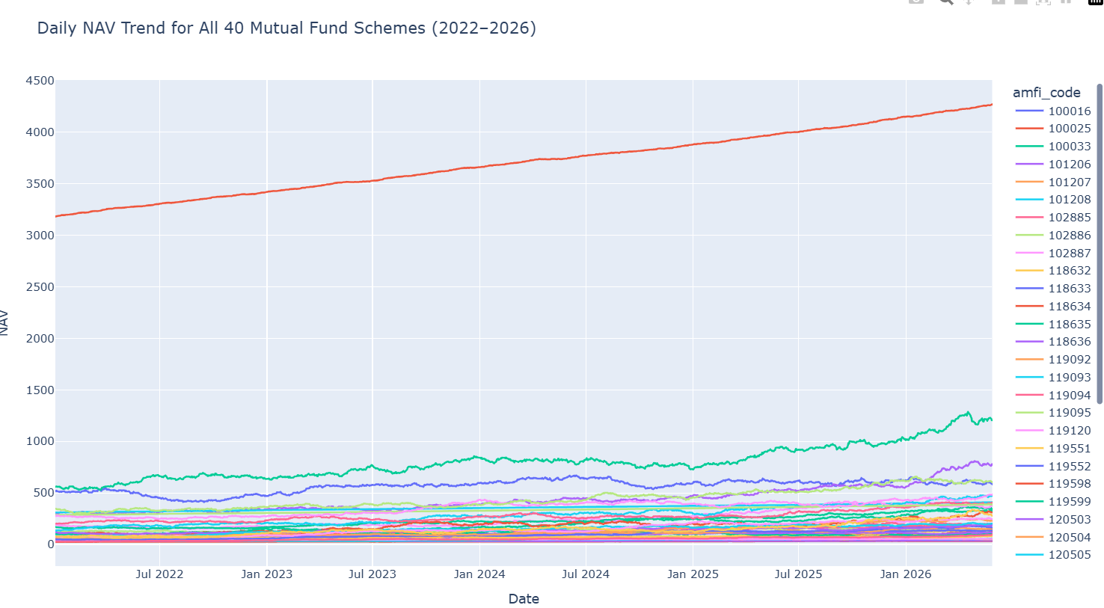
Exploratory Data Analysis (EDA)
Market & Industry Analysis
Key Analyses Performed
NAV trend analysis for 40 schemes.
AUM growth analysis by AMC.
Monthly SIP inflow trend.
Category-wise inflow heatmap.
Folio growth analysis.
Sector allocation analysis.
Key Observations
Strong market rally observed during 2023.
Temporary correction phase during 2024.
Continuous rise in SIP participation.
Equity-oriented funds attracted the highest inflows.

Slide 6
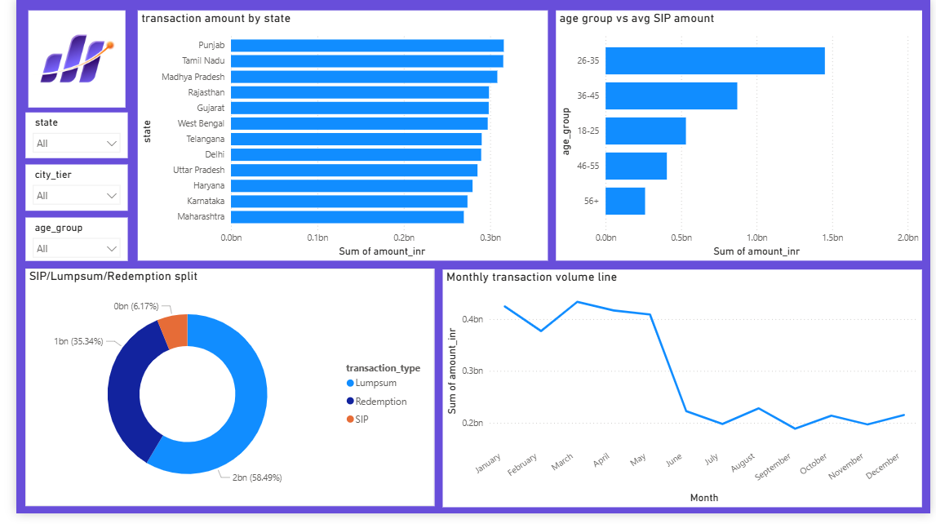
Investor & Portfolio Insights
Investor Analytics
Demographic Analysis
Age Group Distribution
Gender Split
Average SIP by Age Group
Geographic Analysis
State-wise SIP Contribution
T30 vs B30 Participation
Portfolio Analysis
Correlation Matrix
Sector Allocation Donut
Fund Diversification Study
Key Findings
Younger investors dominate SIP investments.
B30 cities are rapidly contributing to mutual fund growth.
Strong positive correlation exists among large-cap funds.

Slide 7
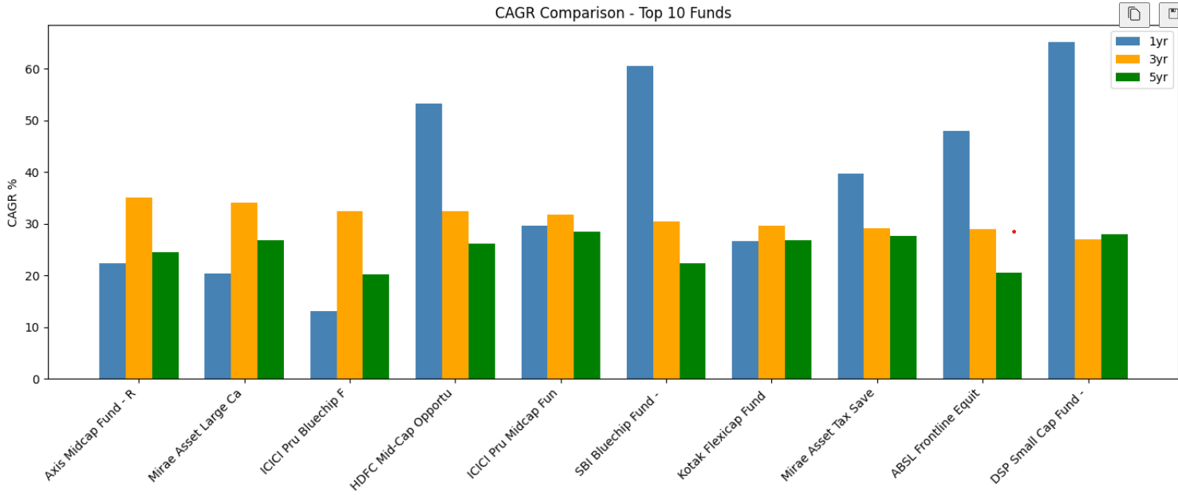
Performance Metrics Analysis
Fund Performance Evaluation
Metrics Calculated
CAGR
1 Year CAGR
3 Year CAGR
5 Year CAGR
Sharpe Ratio
Measures return generated per unit of risk.
Sortino Ratio
Measures return generated per unit of downside risk.
Outcome
Created performance rankings for all 40 schemes.

Slide 8
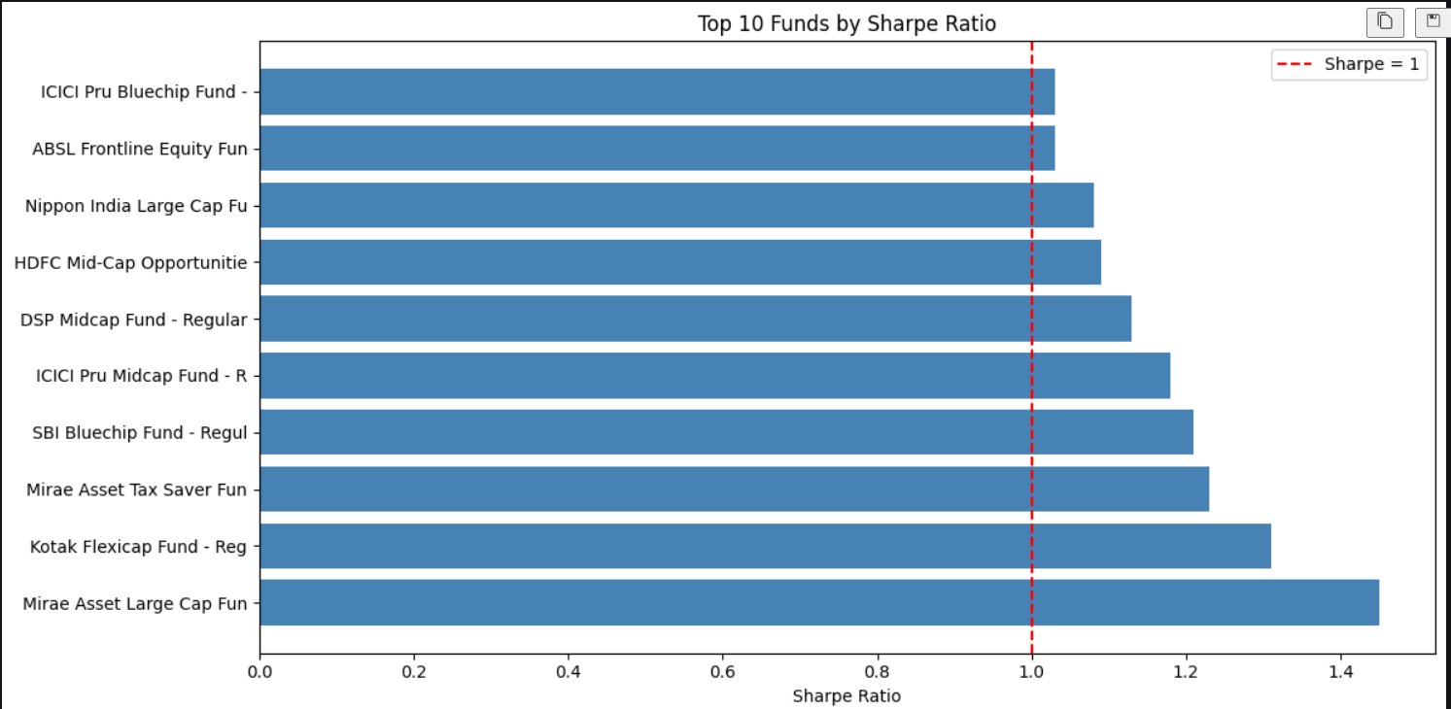
Advanced Risk Analytics
Risk & Benchmark Analysis
Metrics Computed
Alpha
Measures excess return over benchmark.
Beta
Measures market sensitivity.
Maximum Drawdown
Measures largest portfolio decline.
VaR (95%)
Worst expected loss under normal market conditions.
CVaR
Average loss beyond VaR threshold.
Fund Scorecard
Composite Score (0–100)
Based on:
30% Return Rank
25% Sharpe Rank
20% Alpha Rank
15% Expense Ratio Rank
10% Drawdown Rank

Slide 9
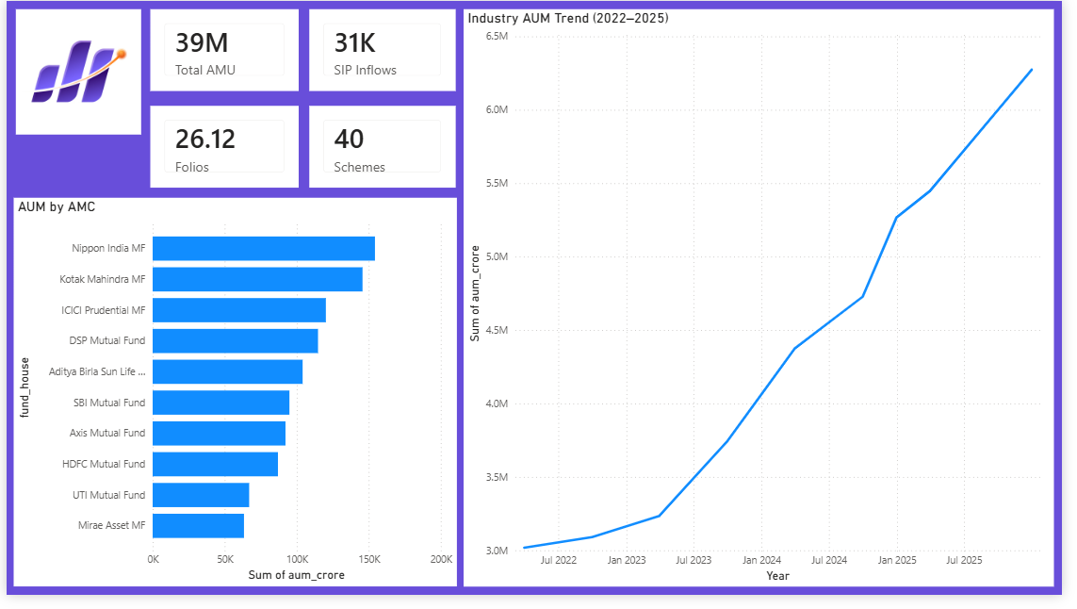
Dashboard Screenshot
Industry Overview Dashboard
Include:
Total AUM KPI
SIP Inflow KPI
Total Folios KPI
Total Schemes KPI
AUM Trend Line
AUM by AMC Bar Chart
Insights
Industry AUM crossed ₹81 Lakh Crore.
SIP inflows reached record highs.
Investor participation continued to expand

Slide 10
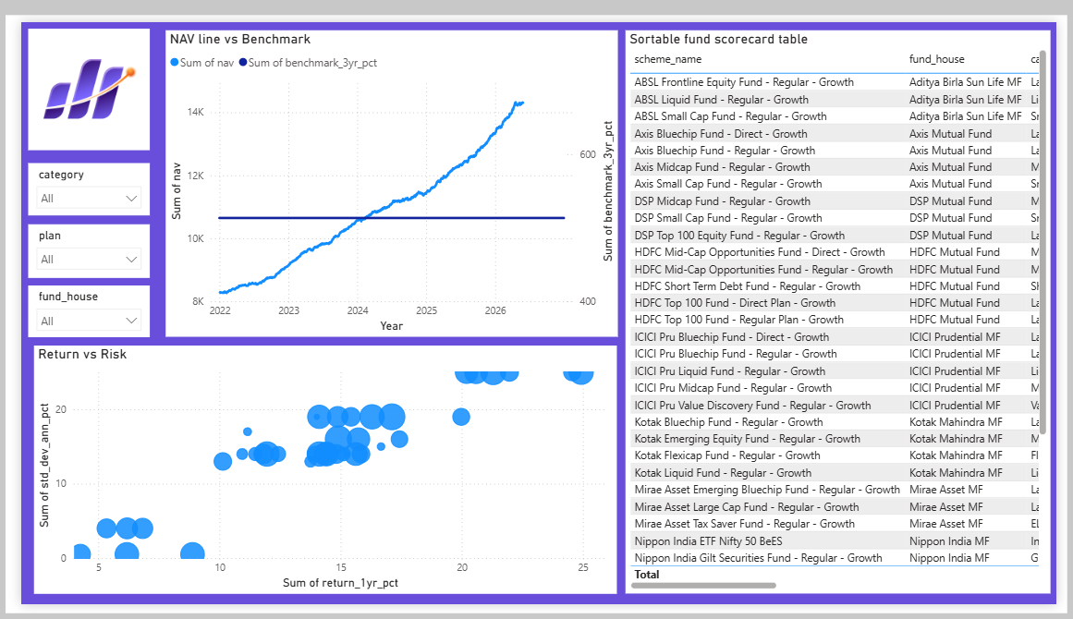
Dashboard Screenshot
Fund Performance & Investor Analytics Dashboard
Show:
Risk vs Return Scatter Plot
Fund Scorecard Table
NAV vs Benchmark
State-wise Investment Analysis
SIP/Lumpsum Split
Age Group Analysis
Insights
Top-performing funds generated superior risk-adjusted returns.
Investor participation varied significantly across regions and age groups.
Fund performance
Investror Analytics

Slide 11
Key Findings & Business Recommendations
Major Findings
Market Insights
SIP inflows reached ₹31,002 Cr in Dec 2025.
Folio count increased from 13.26 Cr to 26.12 Cr.
SBI Mutual Fund maintained market leadership.
Fund Insights
Several funds delivered superior Sharpe and Sortino ratios.
High Alpha funds consistently outperformed benchmarks.
Lower expense ratio funds generally produced better composite scores.
Investor Insights
Younger investors were the most active SIP contributors.
B30 cities showed significant growth potential.
Recommendations
Promote SIP investments in emerging B30 markets.
Focus on high Sharpe, high Alpha funds.
Use risk-adjusted metrics rather than absolute returns alone.

Slide 12
Thank You

